Slide 1
Sheng Guardrails Project
Investigating ways of establishing a guardrail to detect In Topic and Out of Topic discussions in a low resource informal language-Sheng

Slide 2



The context
Organization
Context
Problem
Girl Effect provides adolescent girls and young women with essential information and links to services for immunization, mental health, nutrition, sexual and reproductive health, and early childhood development.
In Kenya, Sheng, an evolving informal language that fuses Swahili and English, widely used, among the youth.
It poses significant challenges for Natural Language Processing (NLP) systems trained predominantly on standard English.
Models often have limited linguistic comprehension for low resource languages such as Sheng due to limited training data and insufficient linguistic representation.
The models are expensive to scale.

Slide 3
Challenges deep-dive
Challenge 1
Challenge 2
Challenge 3
Low resource languages
Models often have limited linguistic comprehension for low resource due to limited training data and insufficient linguistic representation
Misleading or Biased Results
Without sufficient training data and insufficient linguistic representation, models might reinforce stereotypes or produce culturally insensitive outputs.
Poor topic classification
Especially for cross-lingual applications arise when models attempt to perform tasks across multiple languages such as sheng
How do we classify informal languages such as sheng effectively (low cost and compute) with limited data?

Slide 4
Exploring Solutions
Learn shared embedding spaces for classification
Neural Networks
Few shot with OpenAI
Experiments to increase classification accuracy

Slide 5
Approach
Classification
Embeddings
Neural Networks
Vector space
Few shot learning with OpenAI
Classi
f
iers
Davlan/afro-xlmr-mini
sentence-transformers/all-mpnet-base-v2
Logistic Regression
facebook/msmarco
sentence-transformers/all-MiniLM-L6-v2
K-means
facebook/contriever
OpenAI’s text-embedding-3-large
Random Forest
xlm-roberta-base
sentence-transformers/LaBSE

Slide 6
Classifiers
Objective: To automatically identify the decision boundary without relying on manual rule-based methods.
Logistic regression: Supervised, and works well when the decision boundary is linear. Very unstable results
K-Means Clustering: Unsupervised and useful in grouping embeddings without labeled data. Recommended for EDA not final classification.
Random Forest: Able to handle complex, non-linear decision boundaries in the embedding space.

Slide 7
Measures
Accuracy - Proportion of correctly predicted samples.
F1 Score - Harmonic mean of precision and recall.A high F1 indicates the classifier does well on both classes, not just the majority.
ROC/AUC Curve - How well the classifier separates positive vs. negative classes across all thresholds.

Slide 8
Understanding the data set
wz_qa.csv: This is a file with 308 sheng data (questions and answers) that has been vetted and labelled already. The whole data set is IT and the questions + Answers will be combined to provide the vocabulary within the sentence embeddings. It has 2 columns, question and answer
wz_eng_labeled.csv: This contains 117 rows of data in english with labelled classifications of IT/OOT.
human_generated_training_data.csv: This is a 78 Row list of manually generated and labelled sheng data
wz_inference_data.csv: This is a 25455 rows of sheng data that is unlabelled.
human_labeled_inference_results.csv: A subset of 450 rows of sheng data generated and manually labelled as a subset
small_test_data: This is a manual generated and labelled sheng data listing 10 items to allow quick evaluation of accuracy through visual inspection (eyeballing).

Slide 9

Data usage
 | Anchor Embeddings | Neural Networks | Few shot learning | Translation (Sheng-Eng)
Wz_qa.csv (308 rows) | As embeddings data
wz_eng_labeled.csv(117 rows)
human_generated_training_data.csv(78 rows) | As embeddings data | As test data | As examples data
wz_inference_data.csv(24,455)
human_labeled_inference_results.csv (450 rows) | As train\test(0.2) data
Small_test_data (10 rows) as visual test

Slide 10
Findings and Results

Slide 11
Track 1: Embeddings and Cosine Similarity
Generate embeddings using all-mpnet-base-v2, all-MiniLM-L6-v2 and text-embedding-3-large and Classify using Logistic Regression(LR), K-means and Random Forest(RF)
Observations:
In LR, the decision boundary was low at <0.25 cosine similarity, hence displayed bias towards Class 1 with low false negatives, and high false positives
K-means overlap zone was between 0.4-0.7, and although it seemed to have a decision boundary, the accuracy and f1 scores were poor albeit high AUC scores across mpnet and minilm. This drastically changed for text-3-large, where the reverse occurred.
In RF both classes overlap significantly between 0.1 and 0.7, making that region ambiguous. However it performed well across all sentence embeddings models
Classifier | Accuracy (mpnet / MiniLM/3-large) | F1-score (mpnet / MiniLM/3-large) | ROC - AUC (mpnet / MiniLM/3-large)
Logistic Regression | 0.79/0.78/0.84 | 0.88/0.88/0.90 | 0.55/0.55/0.65
K-means | 0.33/0.44/0.73 | 0.5/0.29/0.80 | 0.78/0.80/0.21
Random Forest | 0.83/0.81/0.84 | 0.89/0.88/0.90 | 0.81/0.73/0.75
Notes:
AUC (Area Under Curve): Measures separability (1.0 = perfect, 0.5 = random)
AUC > 0.80: Very good
AUC ~ 0.70–0.80: Moderate, usable
AUC < 0.70: Needs improvement

Slide 12
Track 2: Multilingual Neural Net Models
Explored an additional NLP multilingual models with no fine tuning (used default settings).
Observation: Despite trying several of these models the performance remained low at between 43% and 56% on the higher side.
Conclusion:
Achieve a larger data set for training to test feasibility of Neural Nets for this problem set
Needs fine tuning of the models to achieve better results

Slide 13
Track 3a: OpenAI with prompt B
Prompt B: You are a classifier that determines whether a sentence is about mental, sexual, or reproductive health. The topics include relationships, friendships, sex, abortion, menstruation, abuse, assault, health access challenges, and self-expression for young people. Classify each sentence as:
- 1 (In Topic) if it is relevant to these areas.
- 0 (Out of Topic) if it is unrelated.
Here are examples:{train_df.to_dict(orient='records')}
Sentence to classify: {item}
Answer:
 | Accuracy | F1 Score | AUC Score
gpt-4o-mini | 0.833 | 0.835 | 0.86
gpt-3.5-turbo-instruct | 0.7430 | 0.7436 | 0.73

Slide 14
Track 4: Translations
Translated the smaller data set to English using OpenAI, used text-3-large embeddings and used cosine similarity with Logistic Regression
Observation: Despite the transformation, accuracy and F1 remained below 50%, suggesting translation introduced semantic drift(change or distortion in the meaning of a word, phrase, or sentence when it's transformed ) without improving decision boundary clarity.

Slide 15
Observations and Conclusions

Slide 16
Observations
Semantic meanings in Sheng across both IT and OOT classes are close to each other that it limits the ability of the classification
all-mpnet-base-v2 performed close to text-embedding-3-large has high F1 scores because it is fine-tuned on semantic textual similarity tasks so its embeddings naturally group semantically similar texts closer in vector space.
LR and RF performed above 70% with all-mpnet-base-v2 sentence embeddings while K-means struggled
Few shot with OpenAI's gpt-3.5-turbo-instruct which was added as a benchmark provided similar results to LR and RF
Worth noting is OpenAI's gpt-4o-mini showed a higher results above 80% in both accuracy and F1 scores
Random forest with AUC of >70% and accuracy/f1 scores >81% implies a good useable model, while K-means and LR need more improvement
Test set was randomly generated, however it maintained 19 Class 0(Out of Topic) and 71 (In topic) records which represent a class imbalance. This led to under-training the model on the minority class (leading to high false negatives)

Slide 17
Conclusion
With a curated training data set, the traditional classification models (Logistic Regression, and Random Forest) perform well for topic classification in a low resource language such as Sheng similar to gpt-3.5-turbo-instruct
The models should be trained using a combination of english, swahili and sheng datasets for improved results

Slide 18
Further research
Use of logistic regression with regularization to improve model performance
K-means with k=3 to introduce a grey zone where human intervention may be required to determine if IT and OOT or an alternative model applied
OpenAI with prompt B was used as opposed to the regular prompt A due to tokenization rate limits on inputs. Recommendation is to handle token sizes in the few shot approach

Slide 19
APPENDIX
max growth

Slide 20
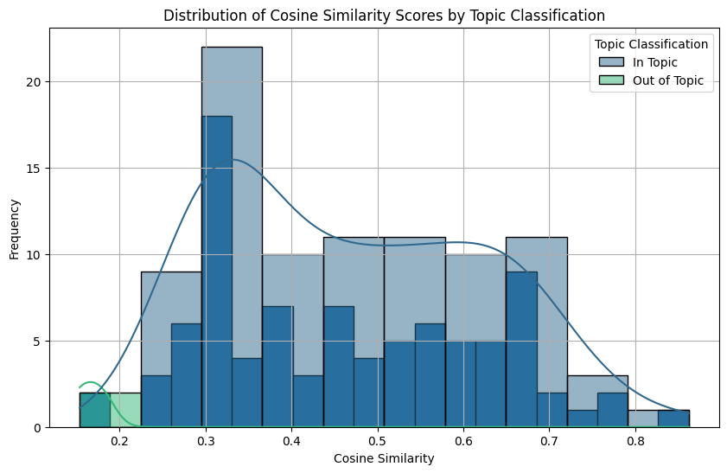
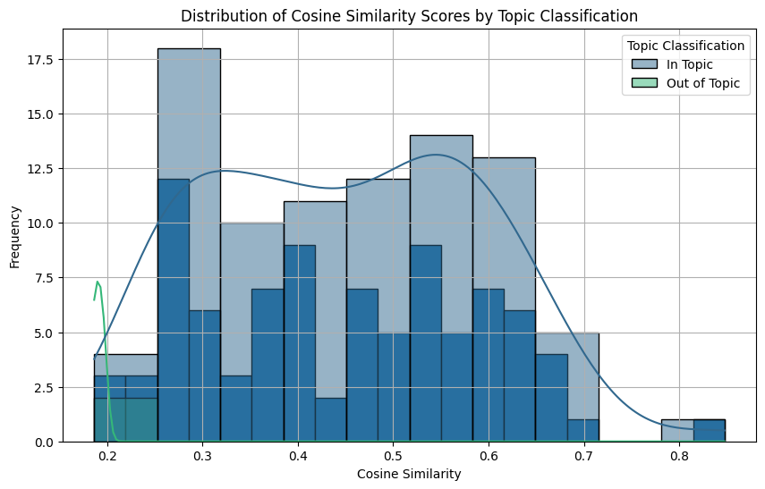
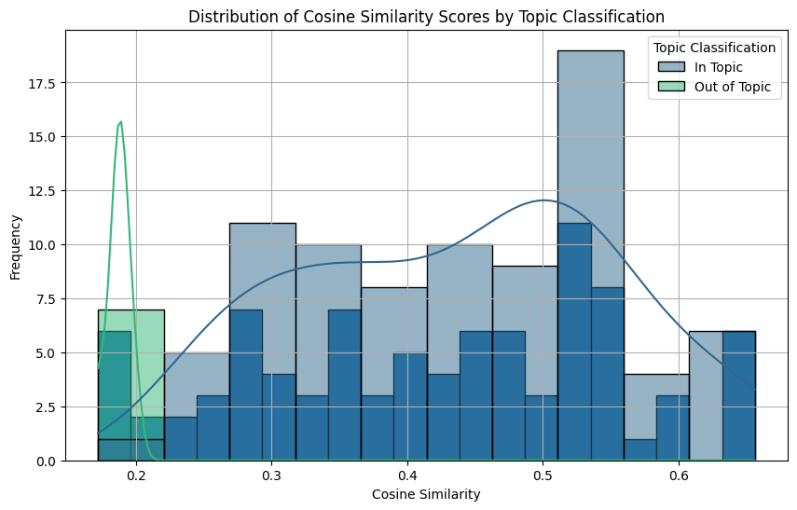
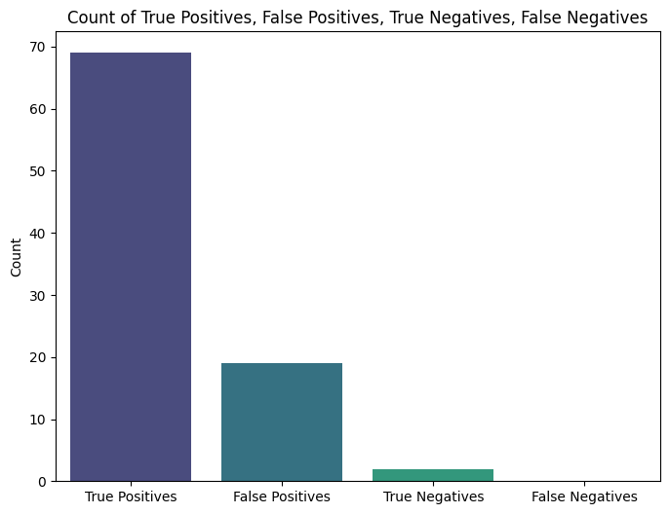
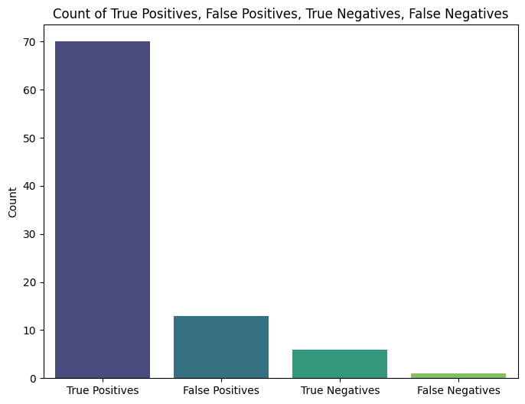
Logistic Regression Distribution
all-MiniLM-L6-v2
text-embedding-3-large
all-mpnet-base-v2

Slide 21
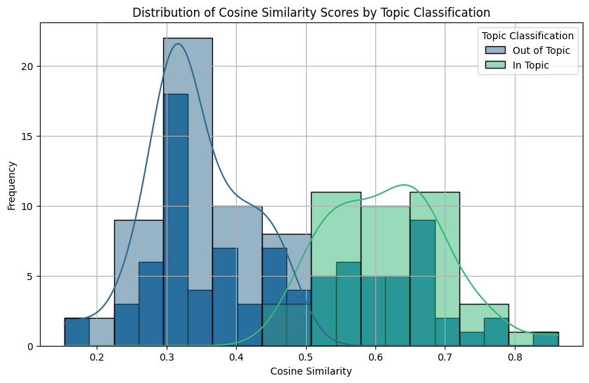
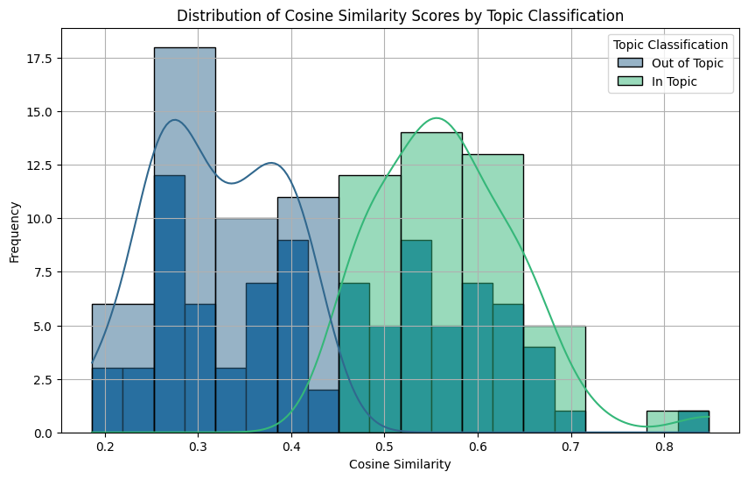
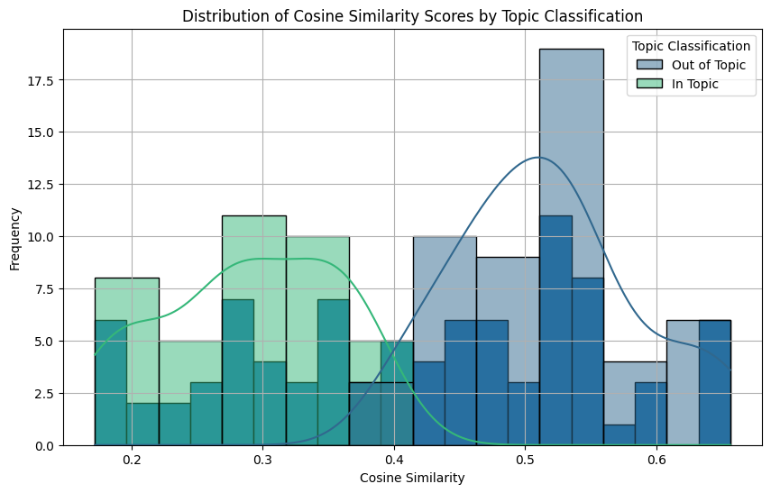
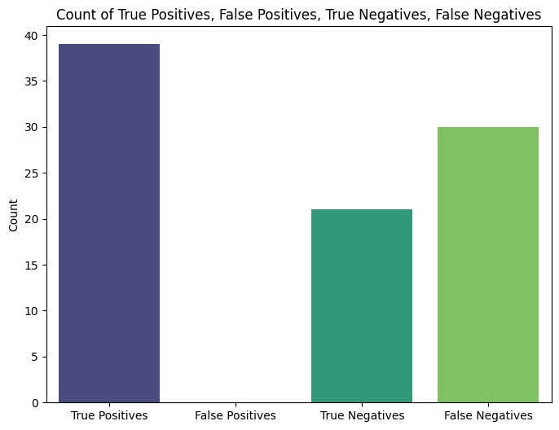
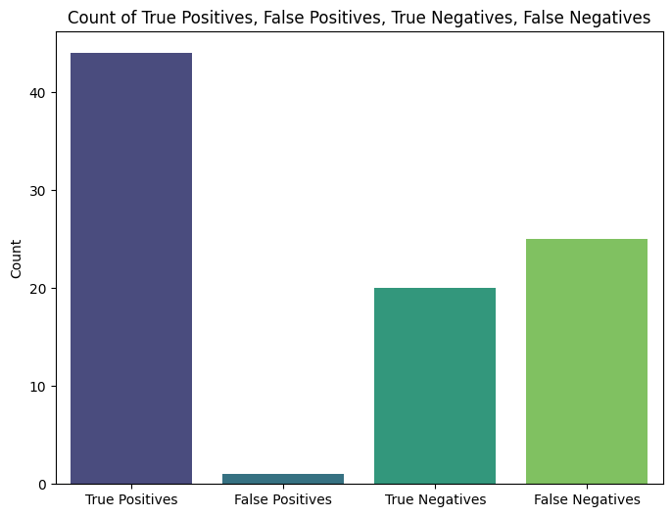
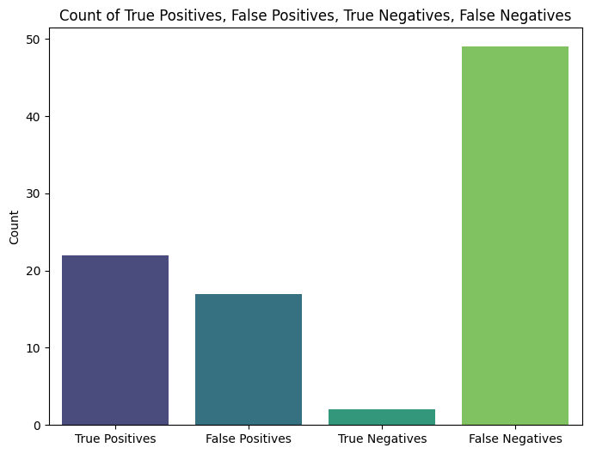
K-means Distribution
all-mpnet-base-v2
all-MiniLM-L6-v2
text-embedding-3-large

Slide 22
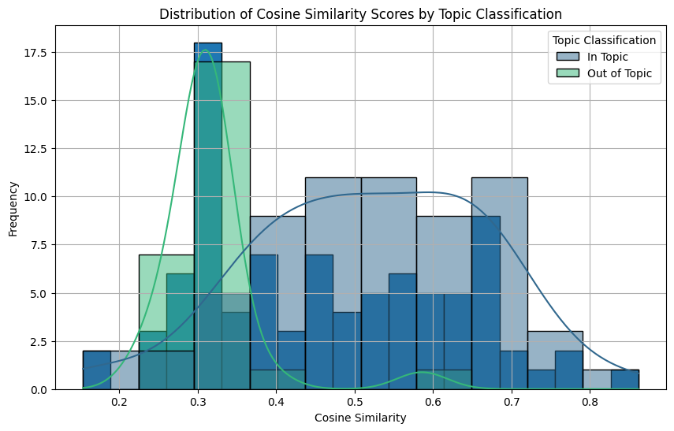
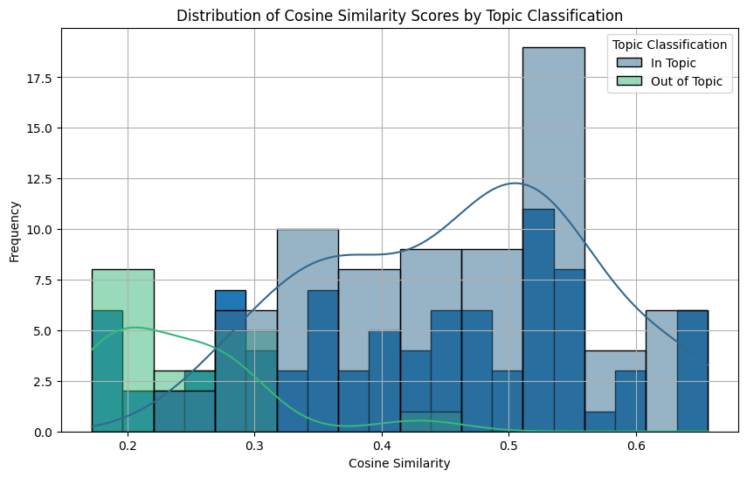
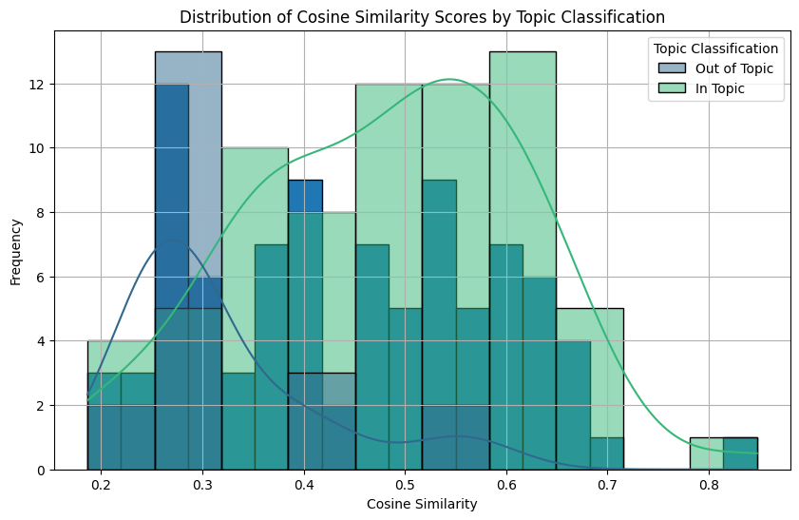
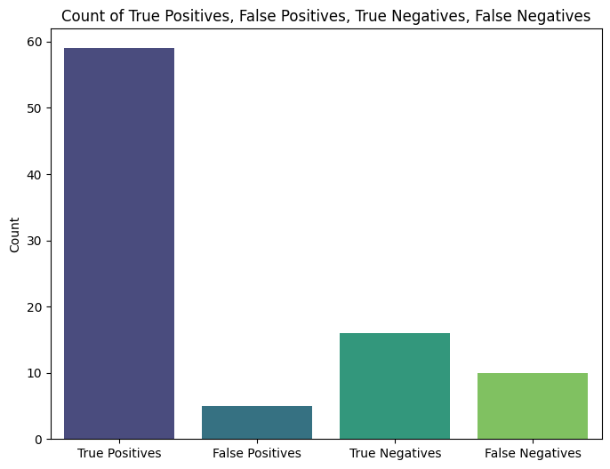
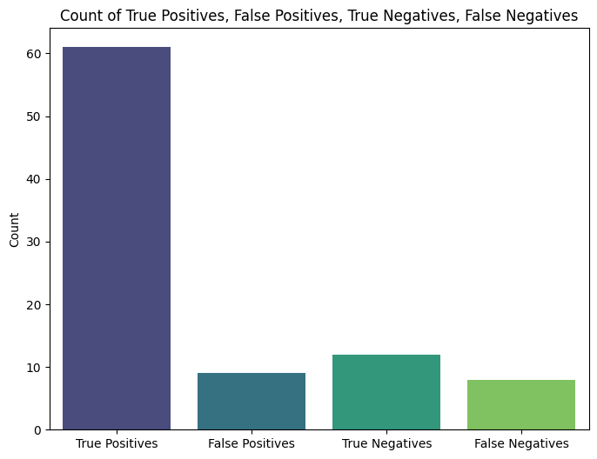
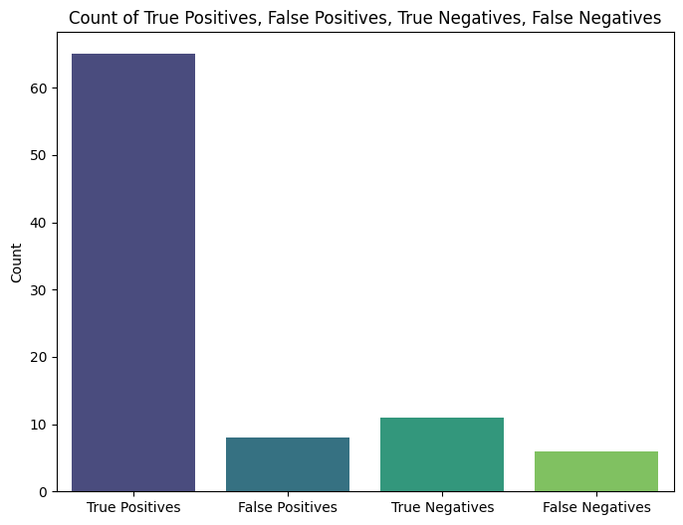
Random Forest Distribution
all-mpnet-base-v2
all-MiniLM-L6-v2
text-embedding-3-large

Slide 23
Track 2: Multilingual Neural Net Models
Track 4: Explored an additional NLP multilingual models with no fine tuning (used default settings).
Observation: Despite trying several of these models the performance remained low at between 43% and 56% on the higher side.
Conclusion:
Achieve a larger data set for training to test feasibility of Neural Nets for this problem set
Needs fine tuning of the models
Model | Validation loss | Accuracy | F1 score
Davlan/afro-xlmr-mini | 0.740749 | 0.500000 | 0.333333
facebook/msmarco | 1.381521 | 0.500000 | 0.333333
facebook/contriever | 0.651121 | 0.562500 | 0.458937
xlm-roberta-base | 0.707880 | 0.500000 | 0.333333
sentence-transformers/LaBSE | 0.959065 | 0.500000 | 0.333333

Slide 24
Track 3: Few-Shot Learning using OpenAI
Track 3: OpenAI's gpt-3.5-turbo-instruct with a few shot prompting approach where some samples were included in the prompt.
Observations: Consistently better performance, with accuracy scores at 75% and F1 at 33%. This was further addressed in the next section.
Prompt: Classify the following sentences as In Topic if they are about sexual reproductive health in adolescents, or Out of Topic if they are about other unrelated topics. Use the examples of sentences are {train_df.to_dict(orient='records')} to classify the following sentences {item} and return comma separated list of predictions as either 1 for IT or 0 for OOT for each of the test sentences.
Classifier | Accuracy | F1-score
Few-Shot Learning | 0.75 | 0.33

Slide 25
Track 3a: OpenAI with prompt A
Prompt A: Please evaluate whether the following user query {item} falls within the scope of topics discussed by the Bis Sis chatbot. Bis Sis is a supportive and fact-driven chatbot specializing in mental, sexual, and reproductive health, with a focus on fostering understanding and providing safe, reliable information. The bot engages in discussions on topics such as relationships, friendships, sex, abortion, menstruation, abuse, assault, health access challenges, and self-expression for young people. Using this guidance and the examples of sentences are {train_df.to_dict(orient='records')}, determine if the user query aligns with these themes. Return only the word Yes or No, without any other character
Not used as it is already in production

